Slide 2
Help! My Child is Being Bullied.
Help! My Child is Being Bullied.
Part Three

Slide 3
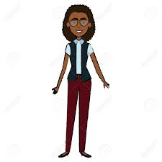
Final Thoughts
Back
Next Slide

Slide 4
06 Building your own resilience
Stage 7: Appreciate simple pleasures
Enjoy the good times in your life; don’t waste them worrying about the bad that might come.
When it is time to celebrate the successes, do so heartily.
Always recognise that everyday you have things to be grateful for.
Know that bad times or trouble are part of life; how you respond to them determines their impact. Expect them and always find a positive in them.
Example: Your job hours have been cut, but on the positive side: you still have a job.
Back
Next Slide

Slide 5
06 PASS IT ON
Teach yourself and your child the three Rs to call upon once they have encountered an incident of bullying.
STAGE 1: Relax -- Spend a few seconds to calm yourself.
STAGE 2: Reflect -- Challenge what you believe.
STAGE 3: Respond -- Cultivate realistic optimism and positivity: with planning effort and problem solving.
Back
Next Slide

Slide 6
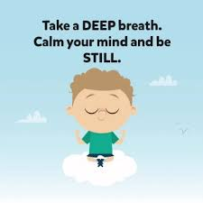
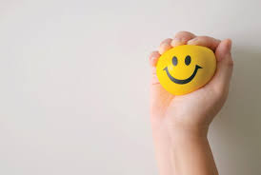
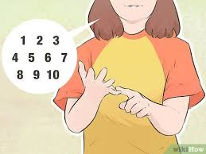
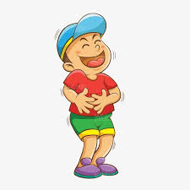
Some Relaxation Techniques
Take deep breths
Squeeze and Release
Recall good memories
Count to 10
Laugh
Back
Next Slide

Slide 7
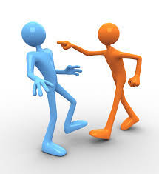
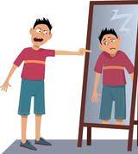
Techniques for Reflecting & Challennging your Assumptions
Stop blaming others
Stop generalizing and having unrealistic expectations.
Stop making things seem worse than they are
Stop blaming yourself
Consider: what else can I do?
Back
Next Slide

Slide 8
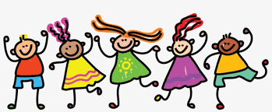
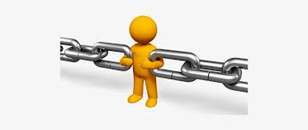
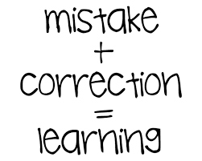
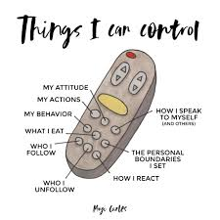
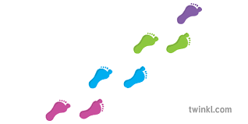
Techniques for Responding to an Incident
Find strength in yourself and others
Learn from mistakes
Express your gratitude
Celebrate your successes
Reach out to others
Take small steps
Control what you can: you
Back
Next Slide

Slide 9
Instruction: Which of the 3 Rs should be practised in each of the scenarios below.
reflect respond relax
I was having a horrible day and I started to imagine even worse scenarios. I need to _________.
I began hyperventilating as the bully that tortured me the previous week approached. I need to ________.
This morning, I was able to tell the boy that bullied me that he is a mean person. Those were the first words I had ever spoken to the bully in my defence. I displayed this R _________.
The first time I was approached by a known bully, I started sweating and my heart was pounding. The next time another bully approached, I stood my ground. I displayed this R _______.
Answer Key
reflect (2) relax (3) respond (4) respond
Back
Next Slide
Back
Next Slide

Slide 10
What are the end results of bullying?
For the Victim
The victim is hurt, possibly lifelong.
The victim becomes depressed and is scarred for life.
In adulthood, the victim still carries and believe the words of the bully, crippling their self-image.
The victim makes the unfortunate decision to end his life.
The victim retaliates in deadly ways (consider at the tragic school shootings).
Back
Next Slide

Slide 11
What are the end results of bullying?
For the Bully
He is hurt (possibly killed) it an act of revenge.
He fails to grow out of that mold and becomes a horrible adult.
He becomes anti-social, aggressive, and controlling as an adult.
In adulthood, he fails to maintain positive relationships because of his attitude and behavior. Including intimate, work, and social relationships.
He gets in constant issues with law enforcement in adulthood.
Back
Next Slide

Slide 12
Some Things to Teach your Kids.
1. Let others know their actions or words are hurtful, if they hurt.
2. Do not pretend that you are not hurt.
3. If your words or actions hurt others, stop speaking the words or doing the actions.
Back
Next Slide

Slide 13
Dorothy Law Nolte “Children Live What They Learn”
If children live with criticism, they learn to condemn.
If children live with hostility, they learn to fight.
If children live with fear, they learn to be apprehensive.
If children live with pity, they learn to feel sorry for themselves.
If children live with ridicule, they learn to feel shy.
If children live with jealousy, they learn to feel envy.
If children live with shame, they learn to feel guilty.
If children live with encouragement, they learn confidence.
If children live with tolerance, they learn patience.
If children live with praise, they learn appreciation.
If children live with acceptance, they learn to love.
Back
Next Slide

Slide 14
Identify two attributes of bullying.
What is social bullying?
Identify one way in which a parent can contribute to the creation of a bully.
Identify one way that a victim of bullying may inadvertently invite bullying upon himself .
Explain two ways in which one can defuse a bully.
Identify two things a parent can give to a child to reduce the risk of them being bullied.
Give one example of how a child that breaks the rules can be bullied.
List the three Rs?
In which of the three Rs is there the instruction to ‘stop blaming others’?
According to Dorothy Law Nolte, what will children learn if they live with acceptance?
Back
Next Slide

Slide 15
End of Course
Thank you for participating!
Next Slide

